Slide 1

Chicago Crime Analysis
Big Data framework
Karthik R 20MIA1154
Abhay Krishnaa Natha 20MIA1102

Slide 2
Chicago is a bustling city located in the Midwest region of the United States. Known for its iconic architecture, rich history, and diverse culture, the city is home to over 2.7 million people and is the third-largest city in the country. Despite its many strengths, Chicago faces several challenges, including high levels of crime and poverty, racial and economic inequality, and a struggling public school system. The city has also been affected by the COVID-19 pandemic, which has had a significant impact on its economy and daily life. Despite these challenges, Chicago continues to be a vibrant and dynamic city, with a thriving arts and culture scene, world-class universities, and a growing tech industry. The city is also home to several major sports teams and is a popular tourist destination, attracting millions of visitors each year.
i

Slide 3
Crime data analysis is the process of using statistical techniques and tools to study crime trends and patterns. It involves collecting and analyzing data from various sources, such as police reports, court records, and crime surveys, to identify patterns and correlations in crime data. Crime data analysis can provide valuable insights into the nature and extent of crime in a particular area, as well as help law enforcement agencies develop effective crime prevention and intervention strategies. It can also be used to evaluate the effectiveness of existing crime control measures and identify areas for improvement. Some of the key statistical techniques used in crime data analysis include descriptive statistics, regression analysis, time series analysis, and spatial analysis. These techniques allow analysts to identify patterns and trends in crime data, predict future crime rates, and develop effective strategies to prevent and reduce crime. Overall, crime data analysis is an essential tool for understanding and addressing the complex issue of crime in our communities. By using data-driven insights to inform policy and decision-making, we can work towards creating safer and more secure communities for everyone.
Crime data analysis is the process of using statistical techniques and tools to study crime trends and patterns. It involves collecting and analyzing data from various sources, such as police reports, court records, and crime surveys, to identify patterns and correlations in crime data. Crime data analysis can provide valuable insights into the nature and extent of crime in a particular area, as well as help law enforcement agencies develop effective crime prevention and intervention strategies. It can also be used to evaluate the effectiveness of existing crime control measures and identify areas for improvement. Some of the key statistical techniques used in crime data analysis include descriptive statistics, regression analysis, time series analysis, and spatial analysis. These techniques allow analysts to identify patterns and trends in crime data, predict future crime rates, and develop effective strategies to prevent and reduce crime. Overall, crime data analysis is an essential tool for understanding and addressing the complex issue of crime in our communities. By using data-driven insights to inform policy and decision-making, we can work towards creating safer and more secure communities for everyone.
i

Slide 4
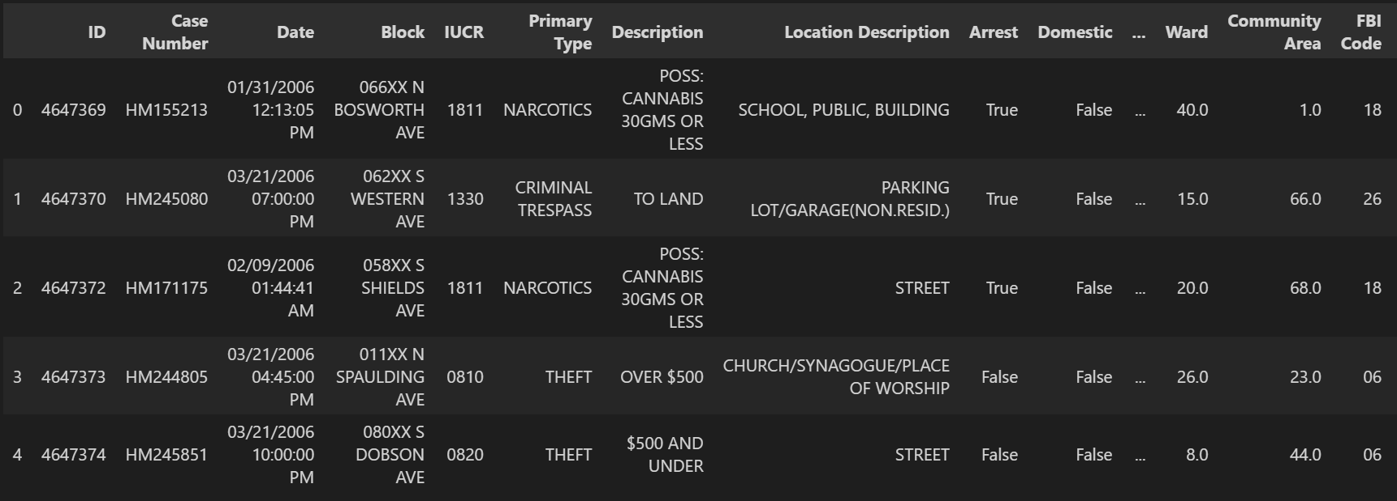
Sample Data
i

Slide 5

The data has almost 6.5 million data records with 22 different attributes that happened over the year from 2001 till 2017.
i

Slide 6
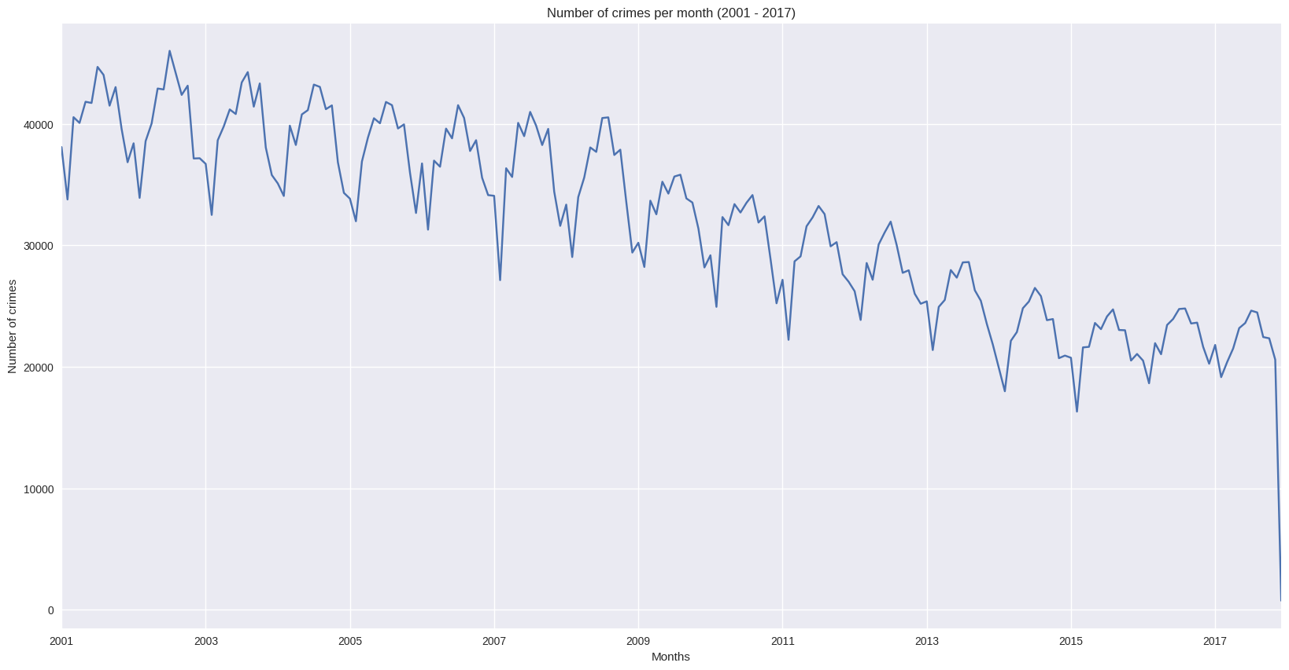
Here is the details of the per month crime that has happened.
We can see that there is a sharp crime fall post 2017
i

Slide 7
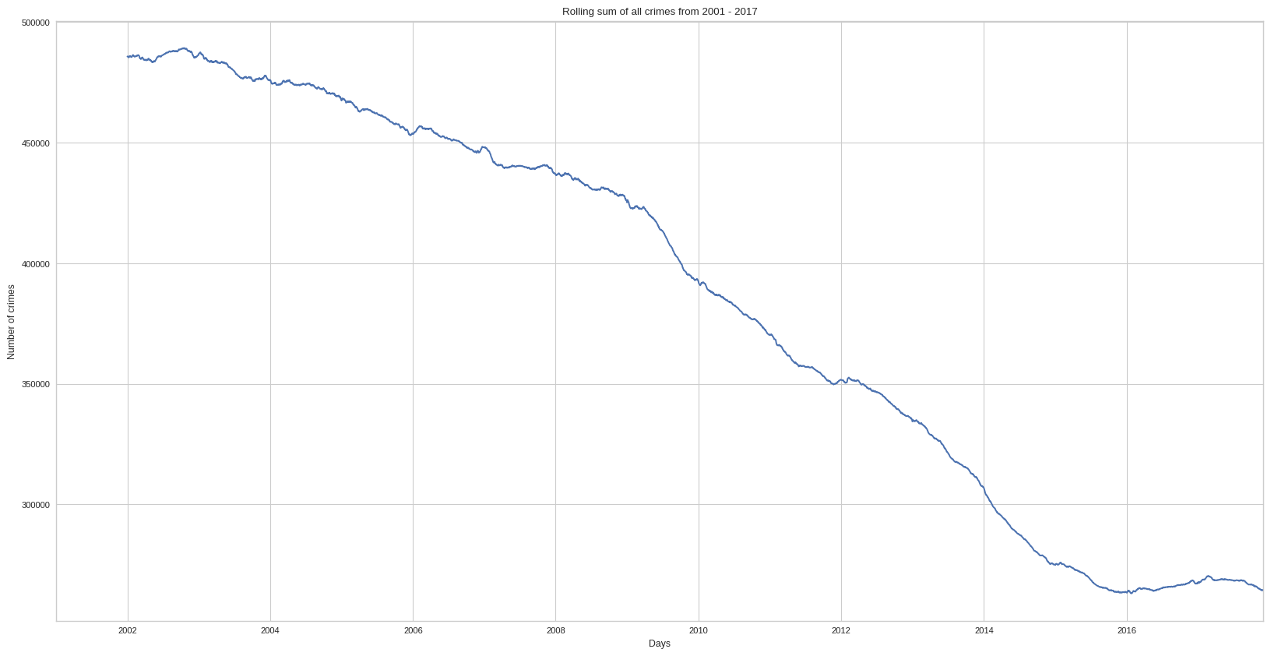
Overall crime rate pattern from the year 2001 till 2017
We can see the gradual drop in the crime rates in the city

Slide 8
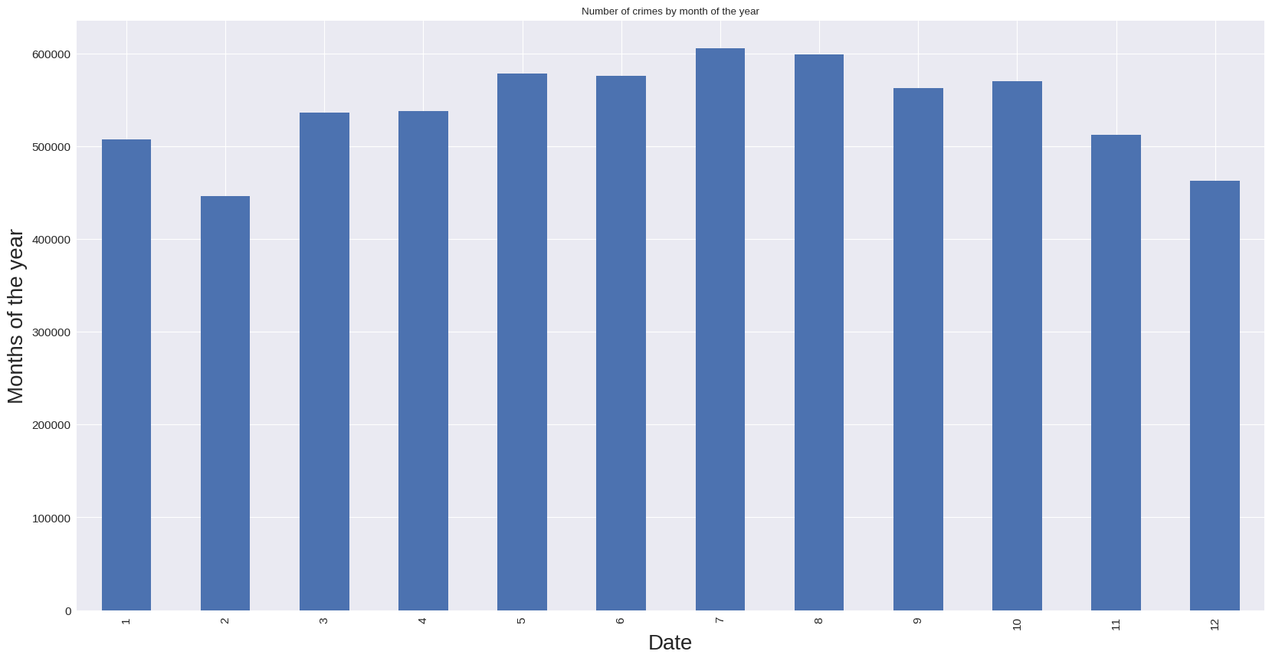
The graph shows the month wise crime committed
i

Slide 9
Overall crime rate pattern from the year 2001 till 2017
We can see the gradual drop in the crime rates in the city

Slide 10
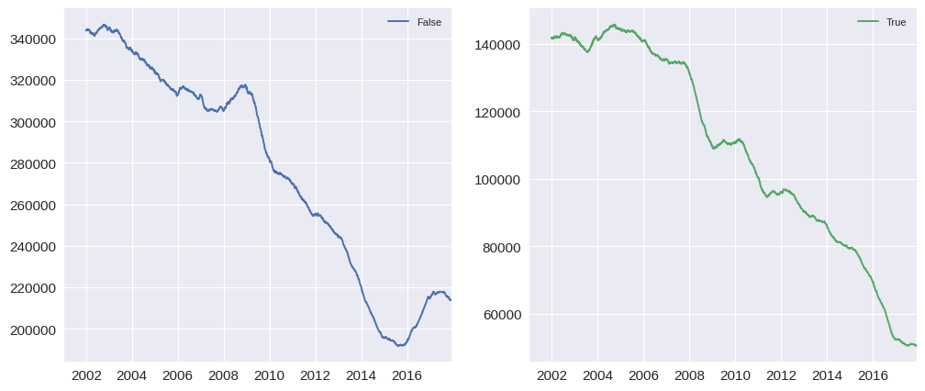
The graph shows the trend of false and positive arrests
i

Slide 11
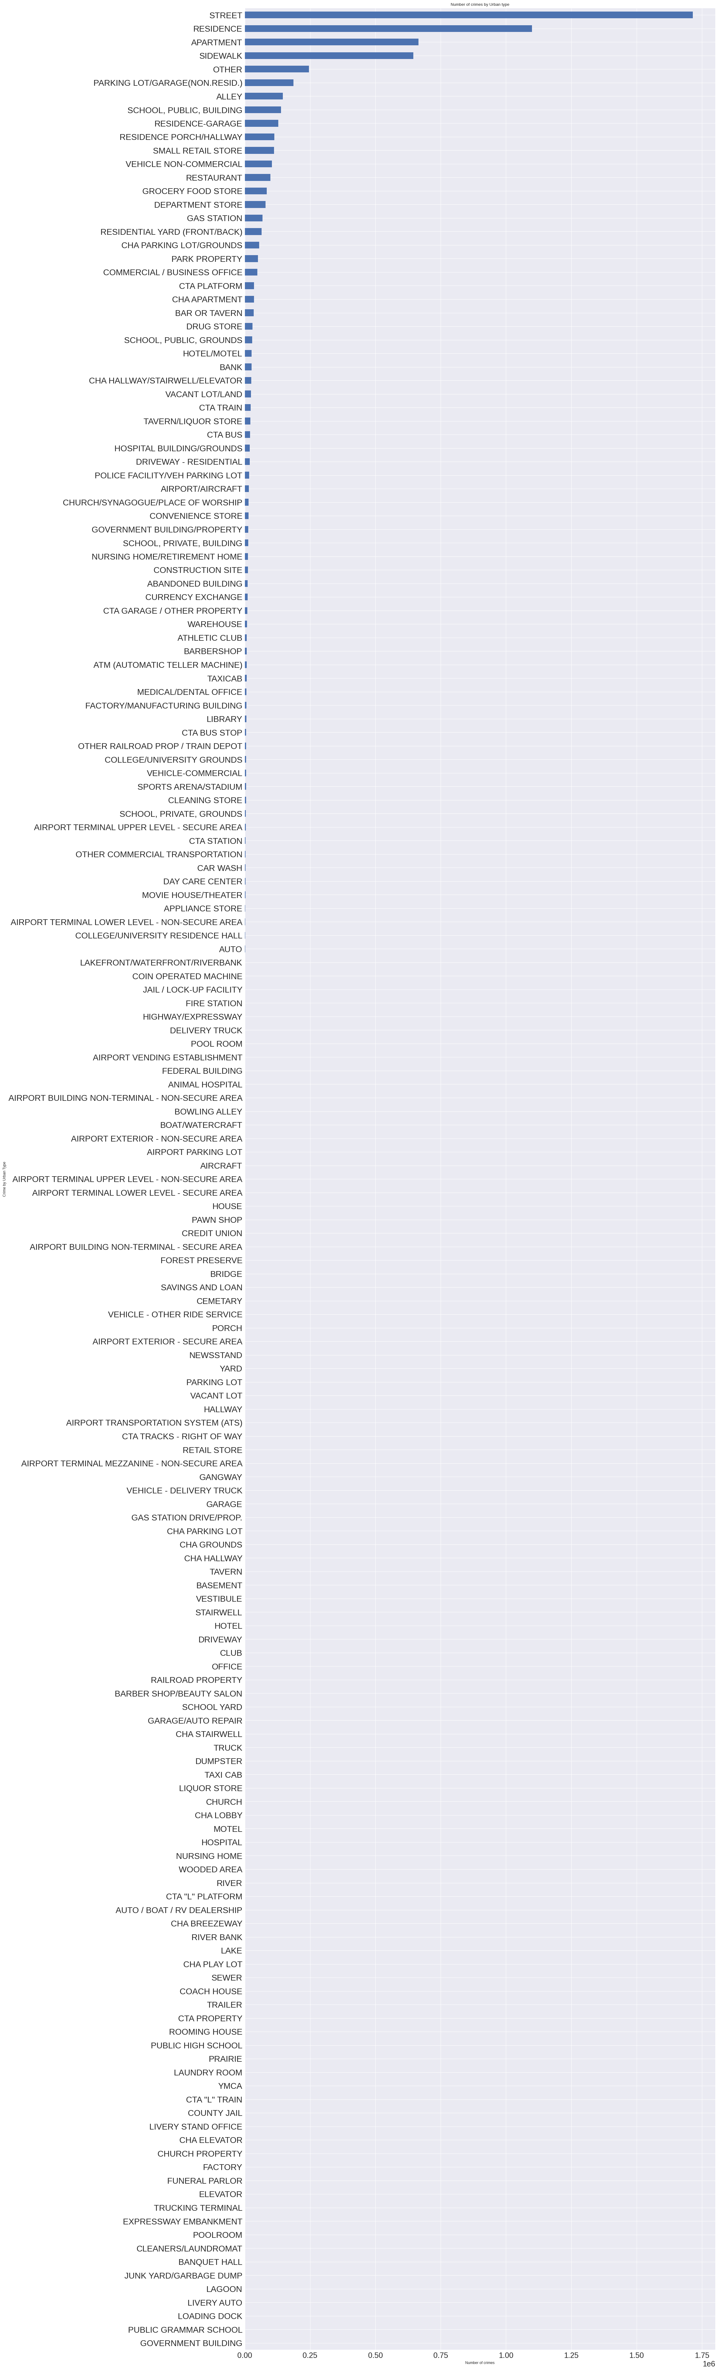
Most frequent crime happening locations
I

Slide 12
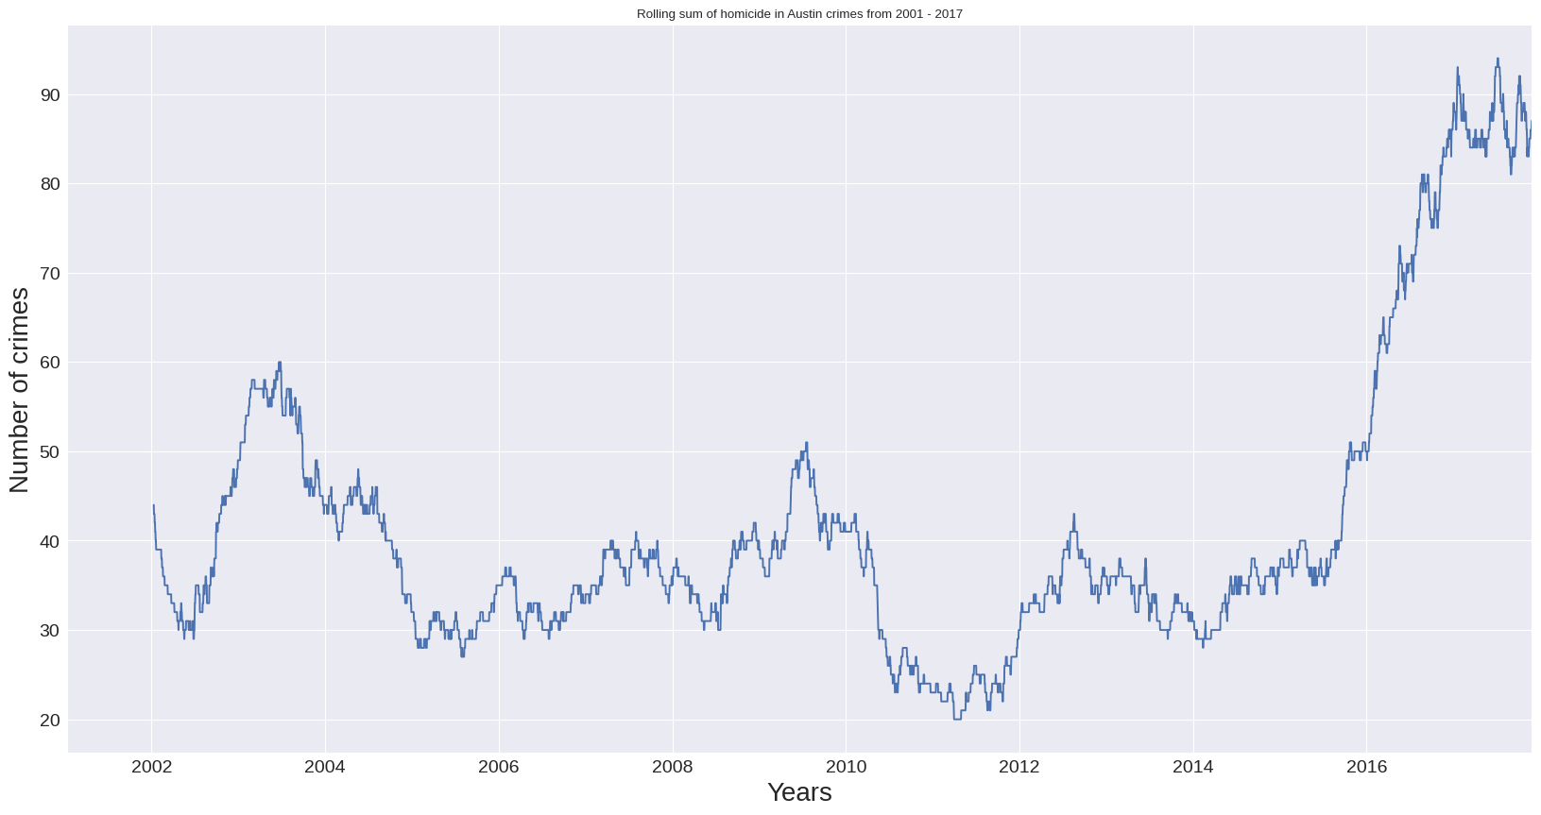
An interesting and important insight on crime called Homicide
I

Slide 13
Chicago has one of the highest crime rates among major cities in the United States, with a particular concentration of violent crime in some neighborhoods. Crime data analysis has been used to study crime trends and patterns in Chicago, and to develop strategies to prevent and reduce crime. Some of the key findings from crime data analysis in Chicago include the concentration of violent crime in certain neighborhoods, the high prevalence of gun violence, and the impact of social and economic factors on crime rates. Crime data analysis has also been used to evaluate the effectiveness of various crime prevention strategies, such as community policing and targeted interventions. Despite ongoing efforts to address crime in Chicago, the city continues to face significant challenges in this area. However, crime data analysis provides an important tool for understanding and addressing these challenges, by identifying trends and patterns in crime data and developing evidence-based strategies for crime prevention and intervention.
i

Slide 14
Thank You
i

